Slide 1
iSKKUBot
RAG-based Multilingual Chatbot for Exchange Students at SKKU
Notes:
This is jiae in team H, and we are developing iSKKUBot, a RAG-based Multilingual Chatbot for Exchange Students at SKKU.

Slide 2

EQUIPO SASHIMI
GeonWoo Bang
JeongYoon Hwang
Jiae Choi
Mikel Larrarte Rodriguez
Notes:
this is our team EQUIPO SASHIMI.

Slide 3
Table of contents.
1
Recap
Motivation & Objective
2
Progress & Role
What have we done & role assignment
3
Method
Progress implementing Indexing & RAG
3.1
Indexing
Progress implementing scraping
3.2
RAG
Progress implementing RAG
4
Demo
Demo of our project prototype
5
UI/UX
UI/UX of our final product
Notes:
Today's presentation will cover the following topics.

Slide 4
Recap
1
Motivation & Objective
Notes:
before diving into the main content, let’s take a look our project’s motivation and objective.

Slide 5
Recap
Motivation
Challenges faced by exchange students (language barrier, scattered information),
and current skku chatbot has its limitations (no multilingual, strict question format)
Objective
Chatbot that provides information necessary for SKKU life
Multilingual chatbot
(kor, eng)
User-friendly
chatbot
(free question format)
RAG chatbot using SKKU web & PDFs data
Reliable data
Reduce LLM’s hallucination
Understand a variety of questions
Notes:
Exchange students often face challenges in finding the school information they need. This is mainly because of language barriers and information scattered across various sources. Although SKKU has an information chatbot, SKKUbot, it doesn’t support multilingual capabilities and requires questions to be asked in a specific format, making it difficult for exchange students to use. That’s why we decided to develop a school information chatbot that exchange students can use easily.
Our objectives can be summarized in three key points.
Chatbot that provides information necessary for SKKU life
Multilingual chatbot which support both korean and english
User-friendly chatbot which can understand free question format
To achieve these goals, we chose to create a RAG-based chatbot using SKKU’s web and PDF data. By relying on trustworthy data sources, we can generate answers that are more accurate than those of a standard LLM, while enabling the chatbot to understand questions in various formats.

Slide 6
Progress & Role
2
What have we done & role assignment
Notes:
This is what have we done and our role assignment

Slide 7
Timeline
 | Week 6 | Week 7 | Week 8 | Week 9 | Week 10 | Week 11 | Week 12 | Week 13 | Week 14 | Week 15
Scrap form Web/PDF |  |  |  | done
Construct Database |  |  |  | done
Implement RAG(Retriever) |  |  |  | In progress
Implement RAG(Generator) |  |  |  | done
Evaluate
Implement Back-end
Implement Front-end |  |  |  | In progress
Notes:
The current timeline is as follows.
today is week 9, we finished scrap from web, pdf and constructing external database.
Actually, we finished scraping data and constructing database in week7, but there were some problems. So in week 8 and 9 we did additional works. I’ll talk about that in next slides.
We’ve been working hard on implementing RAG, retriever part is almost done and generator part is partially completed.
We’ve also started working on the front-end part.

Slide 8
Role
Indexing (Jeong Yoon, Jiae)
Handling tabular data
Construct pinecone database with text, tabular data
RAG (Geon Woo, Mikel)
Model Selection for generator and adjustment
Connecting langchain with pinecone
Prompt engineering & Hyperparameter setting
Front-end (Jeong Yoon, Jiae)
Gradio(for demo)
UI/UX by Figma
Evaluation (Geon Woo, Mikel)
Create some sample test set
Notes:
Jungyoon and I took a part in indexing and front-end, Mikel and 건우 have divided the tasks of implementing RAG and evaluation.

Slide 9
Method
3
Progress implementing Indexing & RAG
Notes:
Now, let's review what we have implemented so far.

Slide 10
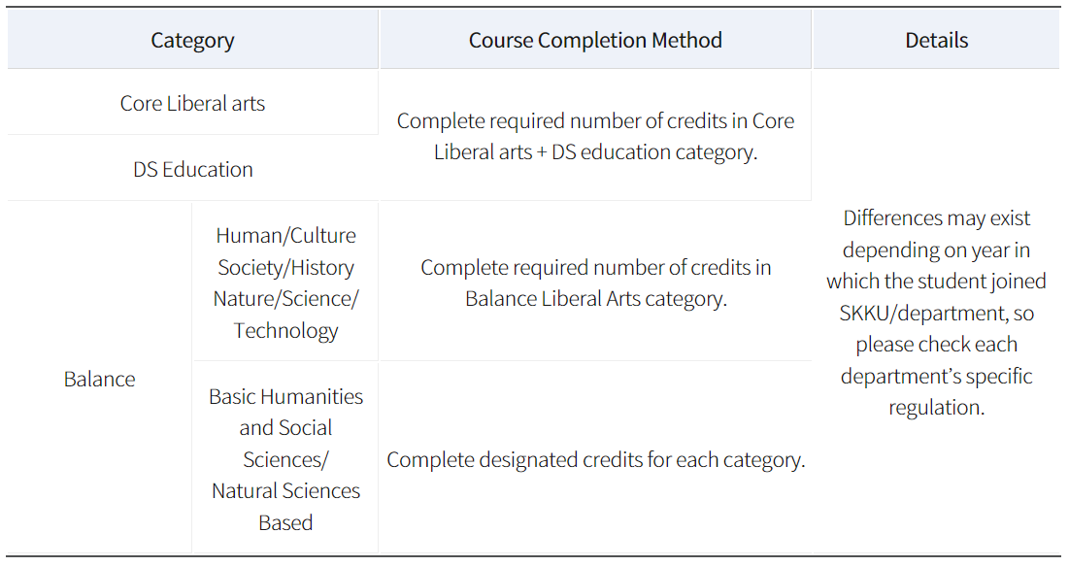
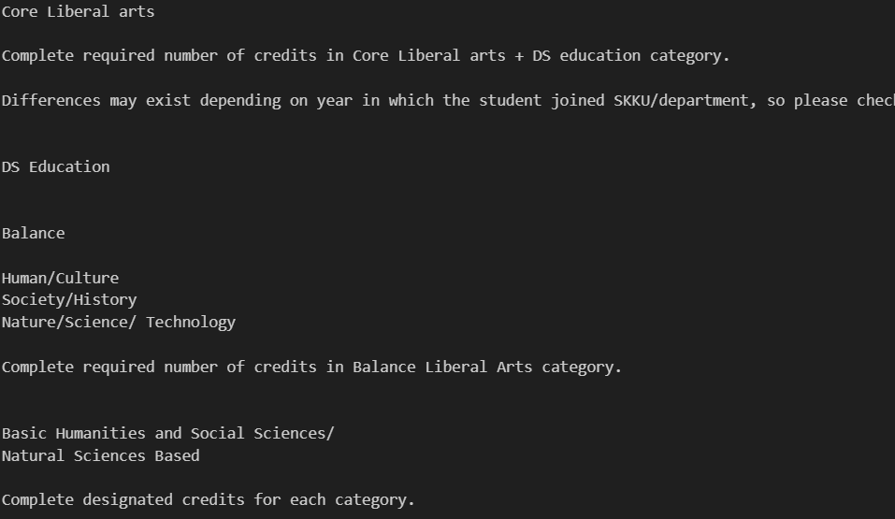
3.1 Indexing - web data
Problem: structured data such as tabular data gets unstructured
Notes:
First, in Indexing part, A problem with using Webbaseloader() to scrap data from web is that the structured data are not handled properly.
It naively turns text from tabular data into plain text, losing its structure.

Slide 11
3.1 Indexing - web data
Solution
Tabular data -> natural language (x)
Tabular data -> json format (0)
There were some automatic tabular data to json converter, but they were not able to handle tables that has multiple spans of rows and columns
-> custom code
Notes:
To mitigate this problem, two solution has discussed.
Converting tabular data into natural language that explains the tabular data properly
Converting tabular data into json format
The second one was chosen because of we want the data to be highly structured.
There were some automatic tabular data to json converter, but they were not able to handle tables that has multiple spans of rows and columns.
Therefore, we implemented with plain python code utilizing BeautifulSoup.

Slide 12
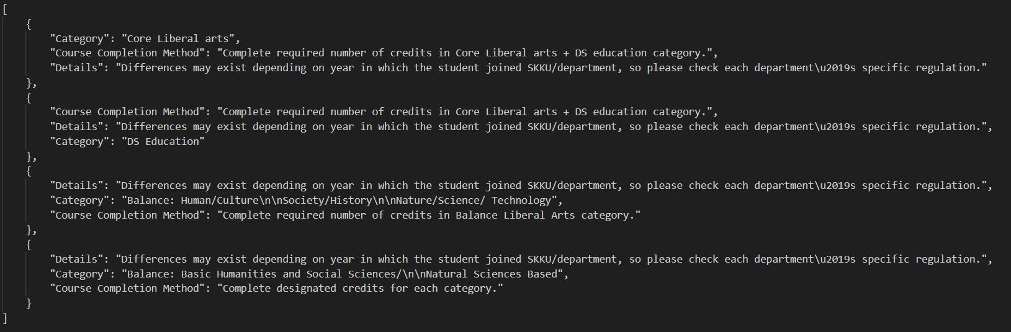
3.1 Indexing - web data
Successfully converted tabular data into json format
Notes:
Now we can see that the tabular data has been converted into json file that captures the structure of original data.

Slide 13
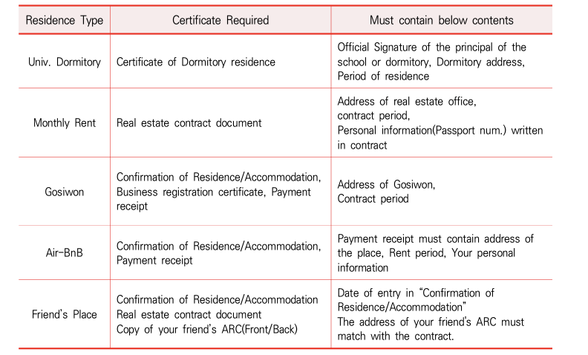
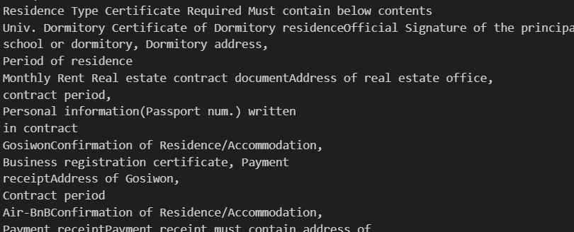
3.1 Indexing - pdf data
Problem 1: structured data such as tabular data gets unstructured
necessary to use a module that can recognize tabular data in PDF
(ex. Unstructured, pdfplumber, …)
Convert tabular data to Dataframe
Notes:
Just like the issue in the web scraping data case, we faced a same problem with PDF data. When using PyPDFLoader, tabular data is extracted as a simple sequence of text, destroying the original table structure. Therefore, we need a PDF content extraction module that can recognize tabular data. Using this module, we can convert the recognized tabular data into a DataFrame and then transform it into a column and value format text.

Slide 14
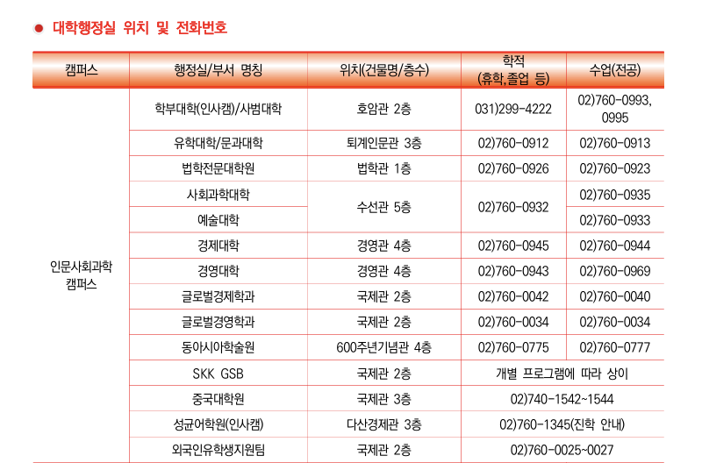
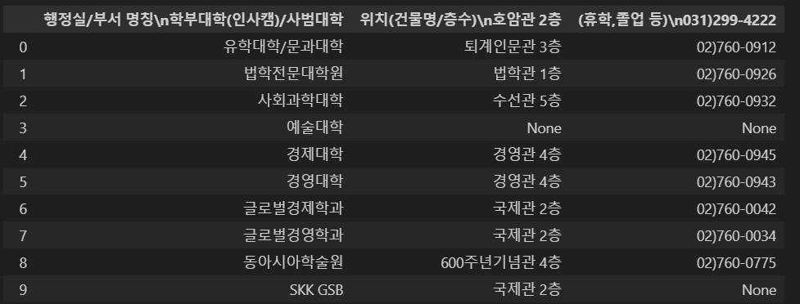
3.1 Indexing - pdf data
Problem 2: Table recognition issue
Result of pdfplumber
Only the part surrounded by lines is recognized as a table.
Notes:
But there is another problem to convert tabular data to DataFrame.
When using pdfplumber with its default settings, it only recognized the parts surrounded by line as tables. However, most of the tabular data in our PDF files is in a table format without lines on either side, so it was necessary to try a different approach.

Slide 15
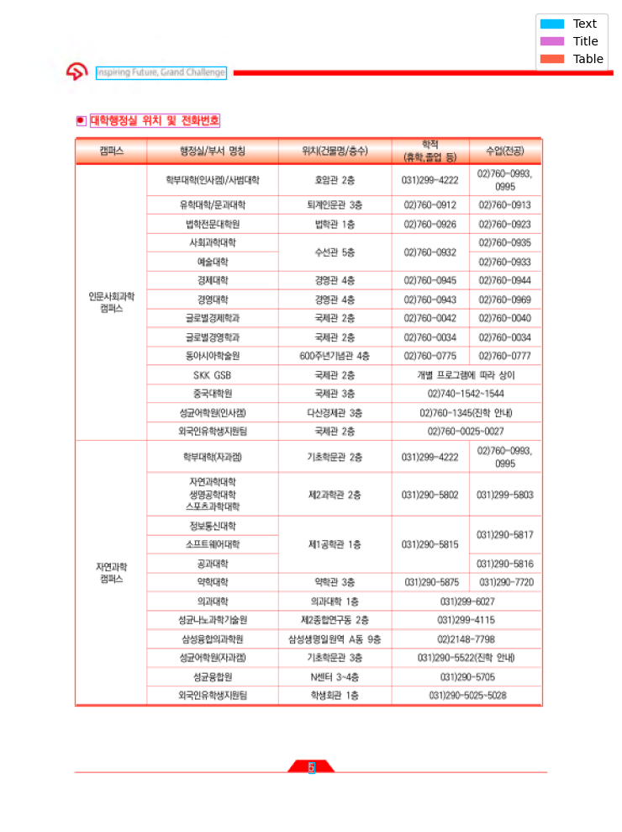
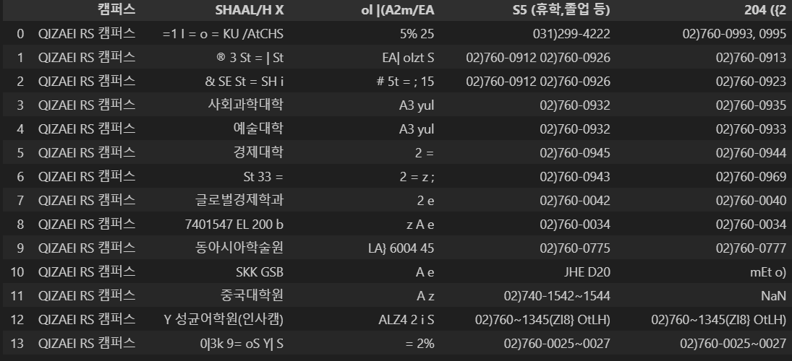
3.1 Indexing - pdf data
Problem 2: Table recognition issue
Result of Unstructured API
many errors in Korean extraction
Notes:
So we tried another pdf extractor, Unstructured API. It catches table correctly like this picture. but has problem to extract Korean in tabular data. It only extracted english tabular data well.

Slide 16
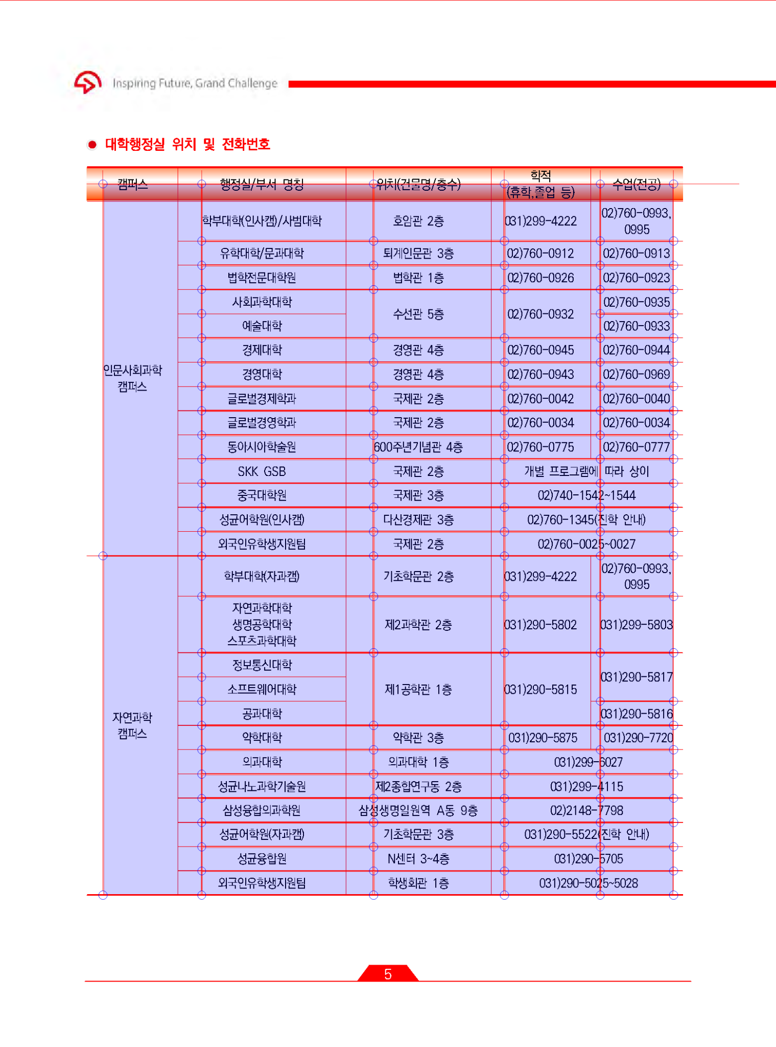
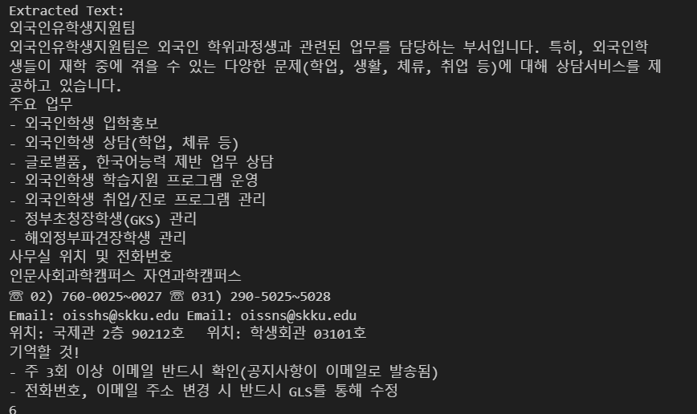
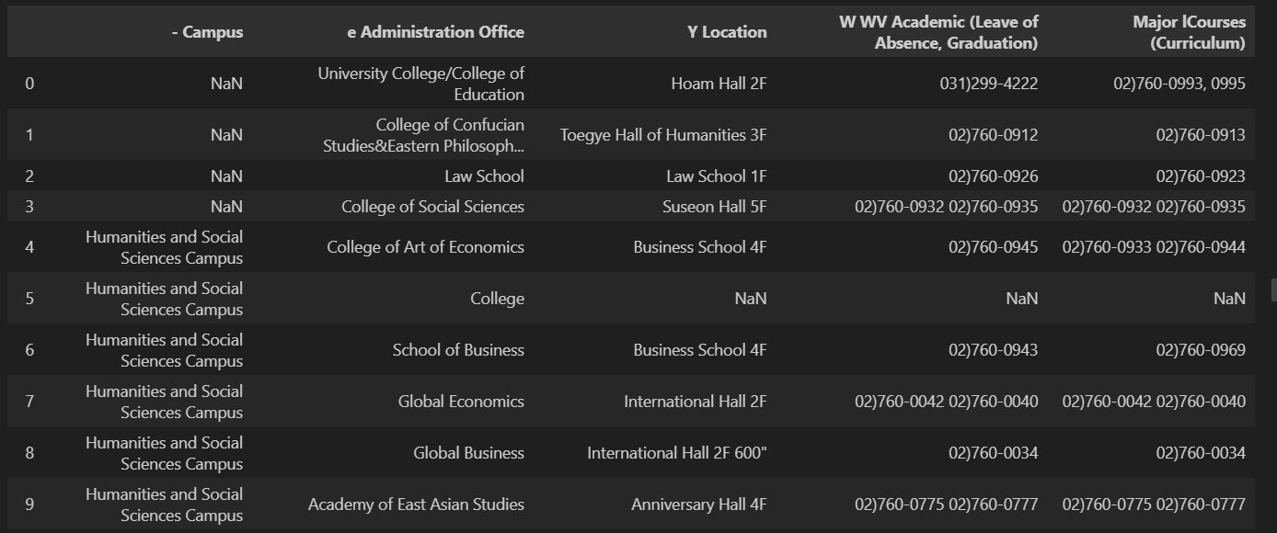
3.1 Indexing - pdf data
Solution
pyplumber : use for text data & korean tabular data
Unstructured API : use for English tabular data
Best extractor for text(kor, eng), tabular data(kor)
Best extractor for tabular data
(eng)
Notes:
After many attempts, we found the best solution, which is to use both extractors. By adjusting a few table recognition settings, pdfplumber can recognize tabular data reasonably better than before. But it’s not perfect yet. Compared to other extractors, pdfplumber performed best with text data and Korean tabular data, while the unstructured API was most effective for English tabular data. Therefore, we used pdfplumber for extracting text data and Korean tabular data, and the unstructured API for extracting English tabular data.
While this solution isn’t perfect yet, we believe that text data can compensate for any errors in tabular data extraction. We plan to gradually modify the database through ongoing evaluations.

Slide 17



3.1 Indexing - store in DB
Text data
Split text
chunks
embedding
Tabular data
embedding
Text data
Split text
chunks
Tabular data (kor)
Tabular data (eng)
Notes:
And this is how to we stored data in pinecone db.
In web and pdf, we extracted text data and tabular data.
Since these were too large to embed directly, the text data went through a splitting process, and each split text was stored as a chunk. However, with tabular data, splitting could destroy the table structure, so we stored it as chunks without splitting.
After creating the chunks, we used the multilingual E5 large model to embed them and stored them in the Pinecone database.

Slide 18
3.2 RAG
Problem: Local Database on model results in management difficulty and significant resource consumption
Model
Database
Database
Data
Retrieve
Model
Notes:
In our previous demo, implementing a vector database using local storage presented significant challenges.
Managing new data became overly complex, and resource consumption was notably high.
Therefore, we decided to use the Pinecone external vector database.
As we mentioned in the earlier section, we completed the process of loading information into the external database.
With this setup, we proceeded to connect it to our generator.

Slide 19
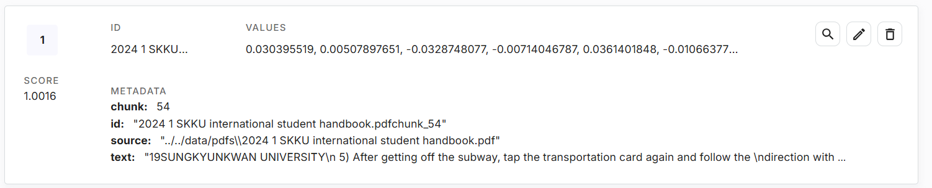
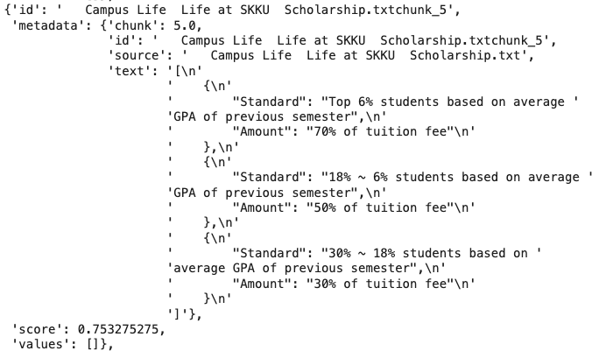
3.2 RAG
Used Cosine Similarity based Pinecone Database.
Implement retriever, Not using RetrievalQA (For Flexible Configuration)
Notes:
Using the Pinecone index based on Cosine Similarity, we successfully embedded sentences, sent the embedding vectors to the external database, calculated similarity, and retrieved the top k most relevant contexts.
This process was designed and functionalized from scratch to allow flexible modifications to our objectives, rather than relying solely on standard RetrievalQA Module.

Slide 20
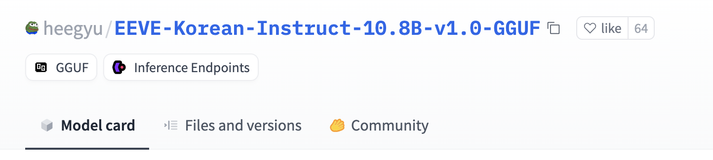
3.2 RAG
Problem: Bilingual Generator Model are not supported
Use EEVE-Korean-Instruct-10.8B from Yanolja. Quantized to Q4_k_m
Pushed to Ollama and served it with ChatOllama
Notes:
Next is the Generator part. In our previous demo, we used Llama-3.1, but this model showed significant limitations in comprehension due to its lack of Korean language training.
To address this problem, we decided to use the EEVE-Korean-Instruct-10.8B model from Yanolja, quantized to Q4_K_M, for improved performance.

Slide 21
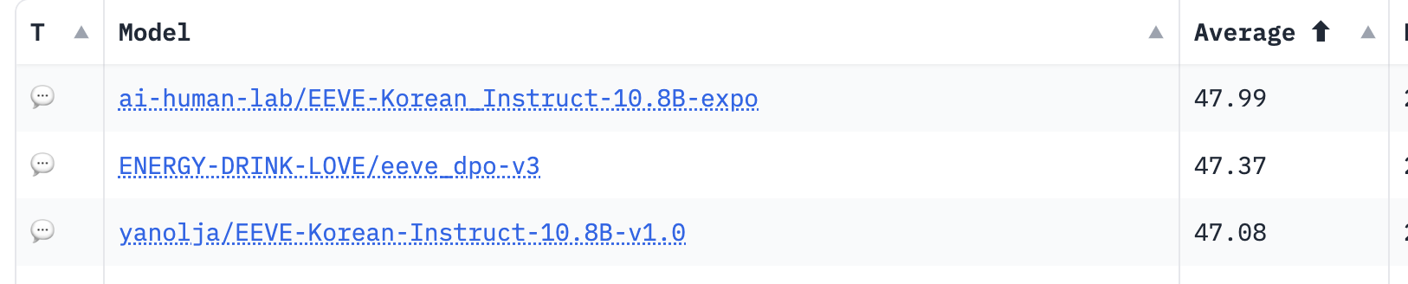
3.2 RAG
Model Selection Reason
3rd Place on Ko-LLM Leaderboard On 7B~13B Models
Well Quantized
Support GGUF format (for Ollama)
Notes:
Let me explain why we chose this model.
The EEVE-Korean-Instruct-10.8B model ranks third among mid-sized LLMs (ranging from 7B to 13B parameters) according to HuggingFace’s Ko-LLM benchmark.
It is well-quantized and supports the GGUF format, making it highly compatible with serving via Ollama.
We chose this model for its advantages and the added reliability of being fine-tuned by a trusted company.

Slide 22
3.2 RAG
Final Prompt Determination for Detailed User Query Responses Aligned with Objectives.
Prompt = f"""A chat between a curious user and an artificial intelligence assistant. The assistant gives helpful, very detailed, and polite answers to the user's questions.
Human: Use given context, answer the following question in detail. This context is about SungKyunKwan University's information(성균관대학교). write based on user's language. Context: {context} \n Question: {query}
Assistant:\n"""
Notes:
Next is the prompt. Previously, we used the default prompt from Llama, but with the model change, we adapted the official prompt provided for this model into an RAG format.
We also emphasized the need for detailed explanations using SKKU-related context to ensure the model fully understands the goal.

Slide 23


3.2 RAG
Pipeline Structuring for Seamless Process Flow, with the Final RAG Pipeline Function Converted for Demo Access via Gradio.
Pinecone
Retrieve
Prompt
Ollama
Stream
iSKKU-Bot RAG Pipeline
Notes:
We designed this entire process as a single pipeline to ensure smooth model operation.
After developing this pipeline function, we created a temporary UI/UX integrated with Gradio to make the demo more interactive.
This UI/UX will be further developed in-house, which I will explain in the next section.

Slide 24
Demo
4
Demo of our project prototype

Slide 25
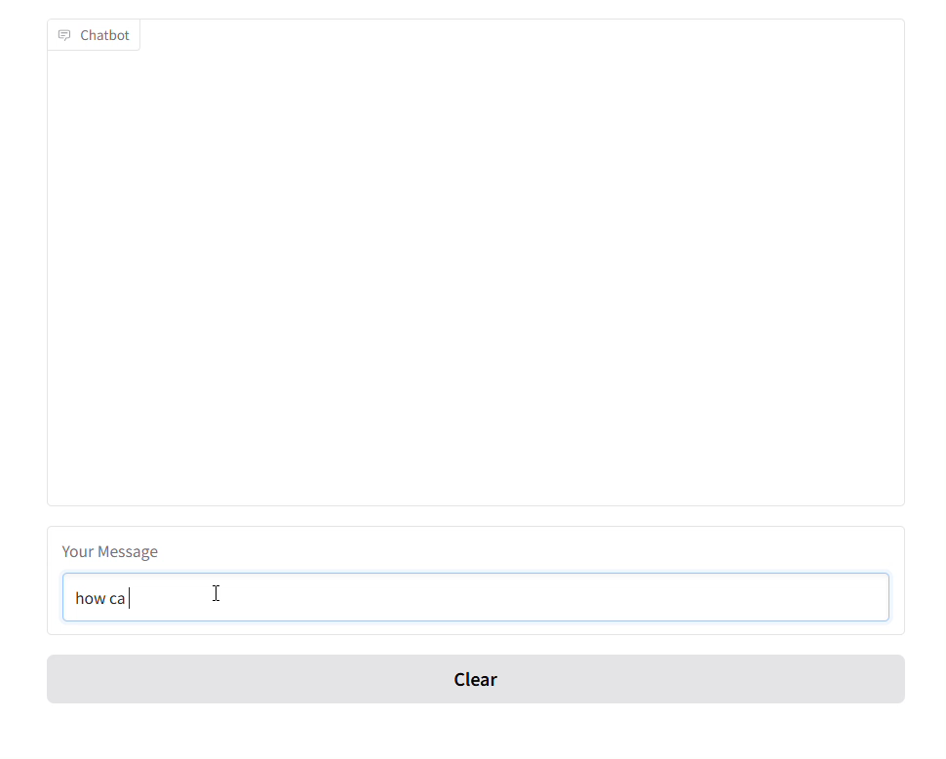
Demo
https://0fb12fc9a18354eea2.gradio.live
Notes:
geonwoo made demo link available in 72 hours. So let’s use the demo now.
For example, i will ask to chatbot “how can i find my classroom?”
And waiting some seconds….
The chatbot returns answer about finding classroom.
There are a few awkward or incorrect parts, but we plan to improve them going forward.

Slide 26
UI/UX
5
UI/UX of our final product
Notes:
Gradio has a limit to custom, so we will develop our own webpage. Let’s take a look our chatbot’s ui

Slide 27
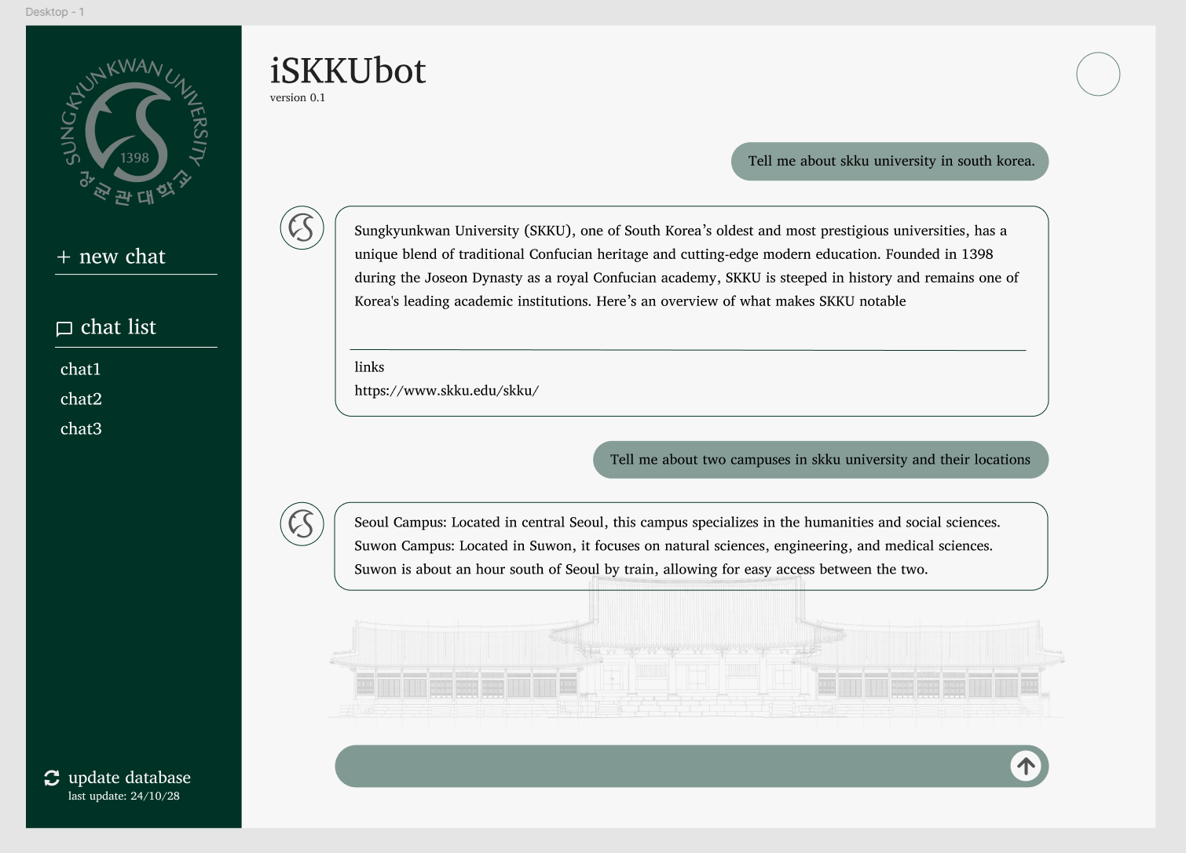
UI/UX
Webpage (PC)
Notes:
This is expected UI of our project.
It is basically a chatbot with some additional features, which are:
The model provides links that it has looked up so that the user always can check out the source of information.
The user can update database to latest information by clicking on the ‘update database’ button on the bottom left side of the page.
But these functions can change depending on the development process.

Slide 28
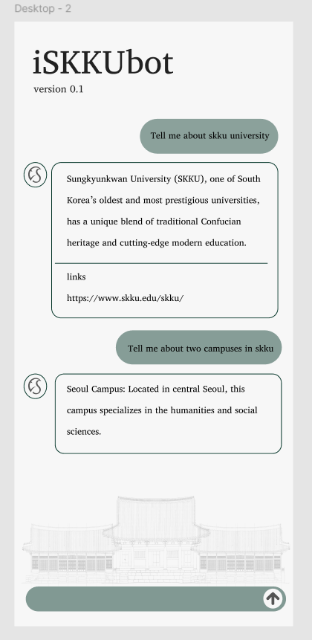
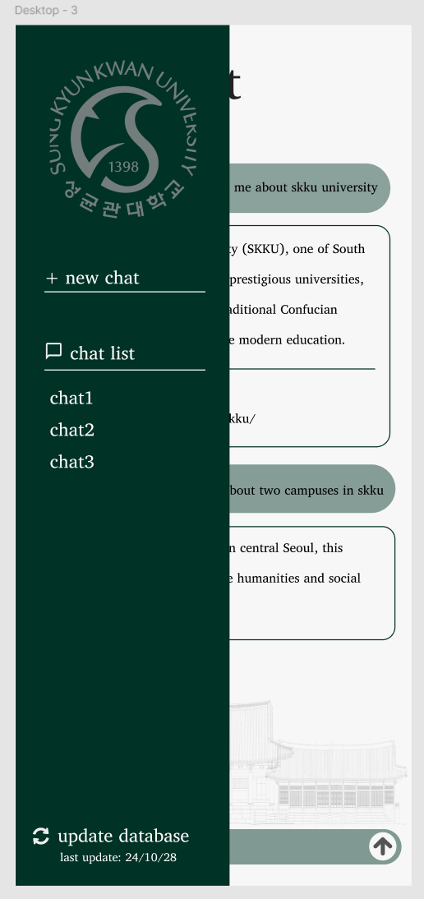
UI/UX
Webpage (Mobile)
Notes:
This is the UI when viewed with a mobile device.

Slide 29
Next task
6
Next todo
Notes:
Now, Let’s take a look at our next steps.

Slide 30

Next Tasks
Frontend - implement webpage
Indexing - embedding model, metric selection, code refactoring
RAG - Making bilingual model api
Evaluation - test with sample data
Backend - Implement API
Notes:
we are planning to do this five steps after this class.
first, we are going to implement webpage
second, we are going to select embedding model and metric and refactor code for update data
third, we are going to make bilingual model api
fourth, we are going to test with sample data
finally, we will implement backend api.

Slide 31
References
https://www.pinecone.io/learn/structured-data/
https://github.com/jsvine/pdfplumber/discussions/1060
https://www.gradio.app/
Notes:
And this is our references.

Slide 32
Thank you!
Do you have any questions?

